Slide 1
MA4605
Question 4
Regression

Slide 2
Question 4a
What kind of analyses are being performed?
lm(formula = Means ~ Conc)
Coefficients:
Estimate Std. Error t value Pr(>|t|)
(Intercept) 2.9238 2.1648 1.351 0.248
Conc 1.9817 0.0715 27.715 1.01e-05 ***
This is unweighted linear regression
fit: y = 2.92 + 1.98x

Slide 3
Question 4a
What kind of analyses are being performed?
weights=SdInt^(-2)/mean(SdInt^(-2))
lm(formula = Means ~ Conc, weights = weights)
Coefficients:
Estimate Std. Error t value Pr(>|t|)
(Intercept) 3.48066 1.15736 3.007 0.0397 *
Conc 1.96315 0.06765 29.018 8.4e-06 ***
This is weighted linear regression
fit : y = 3.48 + 1.96x

Slide 4
Question 4a - Differences (i)
Residual = (observed value of y – fitted value of y )
Unweighted regression requires that the variability of the
residuals is constant over the measured range of values.
(this is called homoskedasticity).
Weighted regression does not have this requirement.
There may be differing variability over the range of values.
This is called heteroskedasticity).

Slide 5
Question 4a -Differences (ii)
Weighted regression requires extra information on the standard deviations of the responses so as to compute the weights.
Unweighted regression doesn’t need or use any information on the response standard deviations.

Slide 6
Question 4a
Weighted regression is preferable if heteroskedasticity evident in the data
(If there is not constant variance for the residuals over the range of values)

Slide 7
Question 4a
Predict x when y=45 for both types of regression
Unweighted (y = 2.92 + 1.98x)
45 = 2.92 + 1.98(x)
solving for x x = 21.25
Weighted (y = 3.48 + 1.96x)
45 = 3.48 + 1.96(x)
solving for x x = 21.18

Slide 8
Question 4b
Quadratic Regression
Linear Regression

Slide 9
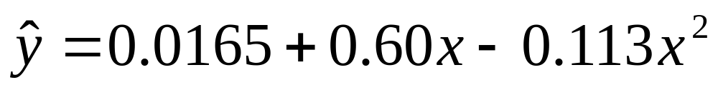
Question 4b
(Linear, Quadratic and Cubic)
lm(formula = Abs ~ Conc + Conc²)
Coefficients:
Estimate Std. Error t value Pr(>|t|)
(Intercept) 0.01651 0.01186 1.392 0.29841
Conc 0.59973 0.03953 15.172 0.00432 **
Conc² -0.11288 0.02483 -4.546 0.04514 *
This is Quadratic regression
Fit

Slide 10
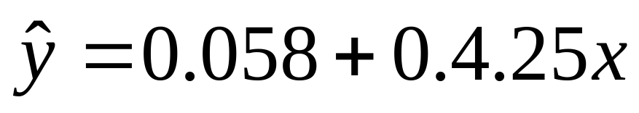
Question 4b
(Linear, Quadratic and Cubic)
lm(formula = Abs ~ Conc)
Coefficients:
Estimate Std. Error t value Pr(>|t|)
(Intercept) 0.05829 0.02060 2.83 0.066209 .
Conc 0.42502 0.02544 16.71 0.000467 ***
This is Linear Regression
Fit

Slide 11
Question 4b
Linear regression requires a “straightline” trend, and disallows any curvature and peaks in the trend
Quadratic Regression does allows curvature and peaks, but disallows any straightline trends
Linear regression requires one less parameter than quadratic expression

Slide 12
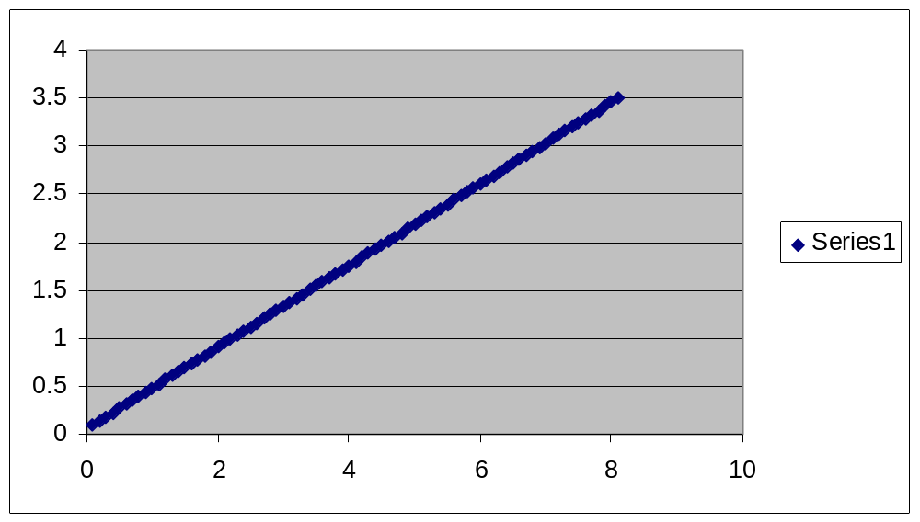
Question 4b – Linear fits

Slide 13
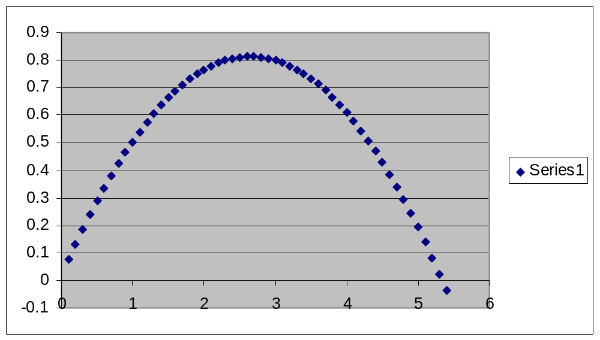
Question 4b - Quadratic Fit

Slide 14
Question 4b
Residuals
Compare the absolute value of both sets of residual for each observation.
The fit that indicates the smallest residuals is preferable.
(i.e. more accurate)
Apart from the second observation, all of the linear residuals have greater absolute values than the corresponding quadratic residual.
Quadratic is seemingly more accurate.

Slide 15
Question 4b
 | Quadratic | Linear
R² | 0.9991 | 0.9894
Adjusted R² | 0.9981 | 0.9858

Slide 16
Question 4b
The model with the highest R² and adjusted R² is the preferable of all candidate models
The Quadratic Model is the preferable model in that case.

Slide 17
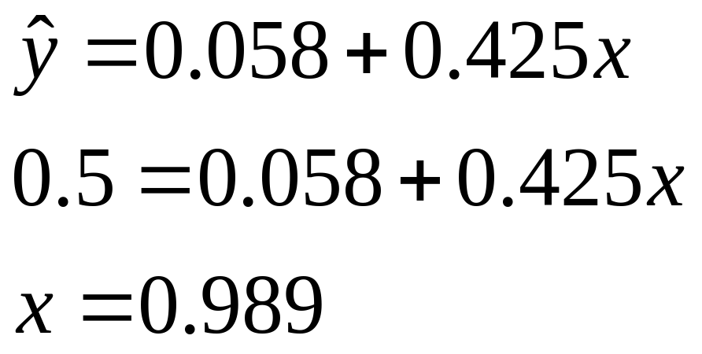
Question 4a
Predict x when y=0.5 for both types of regression
Linear

Slide 18
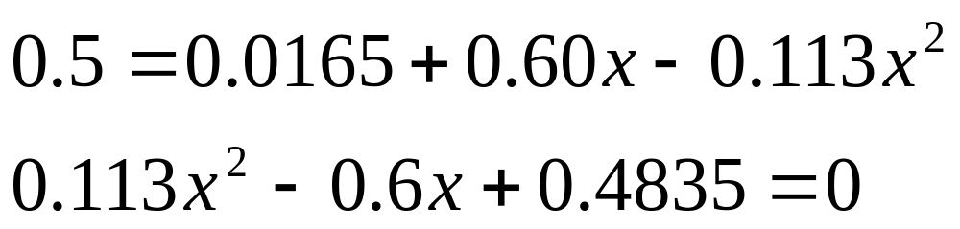
Question 4b
Quadratic
Solutions 0.99 , 4.32
Only use 0.99 because other value is outside range

